Slide 1
Software lab in Bioinformatics
From Histology To Automatic Cell Type Prediction
Presented by
Max Zimmer, Richard Raatz, Poson Kuruppu, Michaela Schever

Slide 2


Motivation
Why do we care?
Understanding cellular composition key for
Disease diagnosis
Rapid treatment response
Accuracy of diagnosis
But …
Time & labor intensive
Expensive $$$
Prediction of cell types based on Image
Faster
Cheaper $
Can assist traditional annotation process

Slide 3
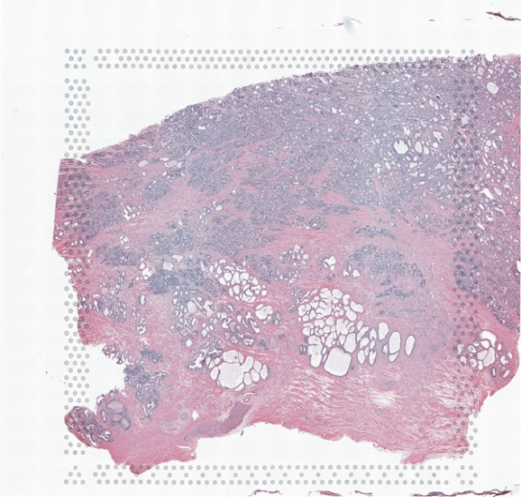
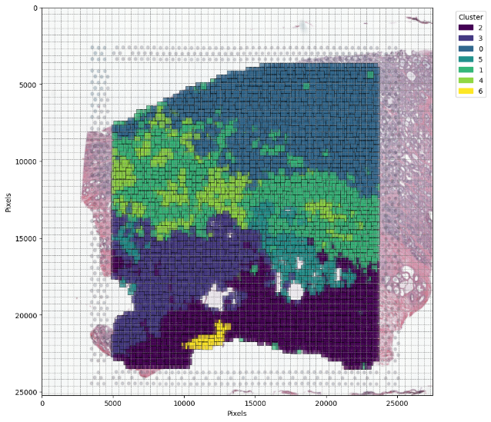
Problem Setting
Can we predict cell types from histology?
Given TIF image ⇨ predict the cell types
TIF image as a visual capture of Slice
Cell types represented by clusters
Clusters are created over gene sequence data
Main Goal: Create a model that looks at histology and outputs a useful cell type prediction
TIF image of tissue slice Source: 10X

Slide 4

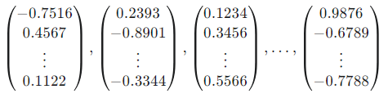
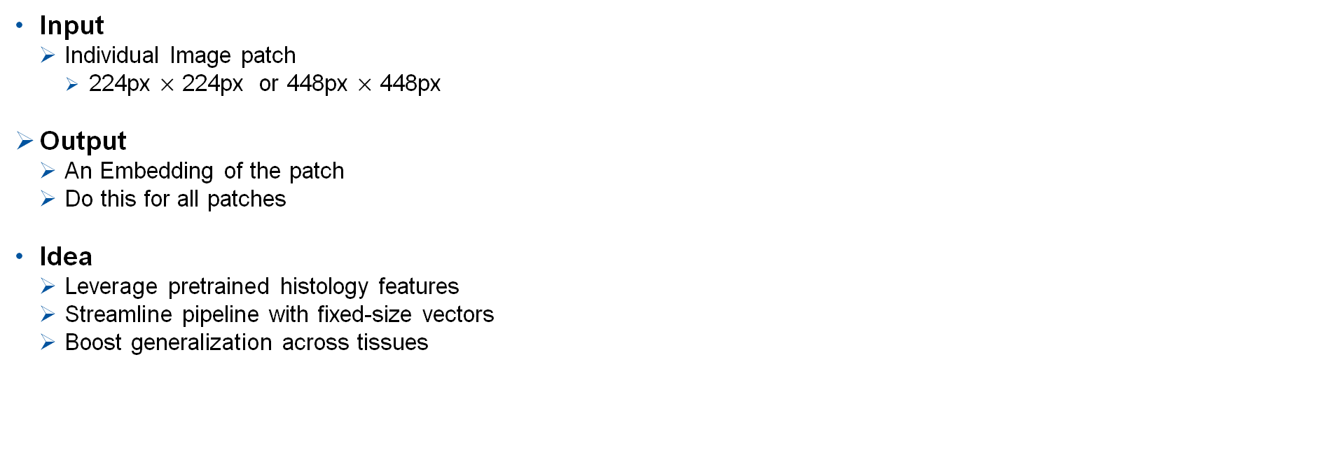
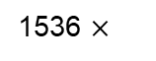
Extraction of Histology Embeddings
Processing Step 1 – UNI2 Pretrained Model
Input
Individual Image patch
224px $×$ 224px or 448px $×$ 448px
Output
An Embedding of the patch
Do this for all patches
Idea
Leverage pretrained histology features
Streamline pipeline with fixed-size vectors
Boost generalization across tissues
UNI2
TIF image of tissue slice Source: 10X
Embeddings
1536 $×$

Slide 5
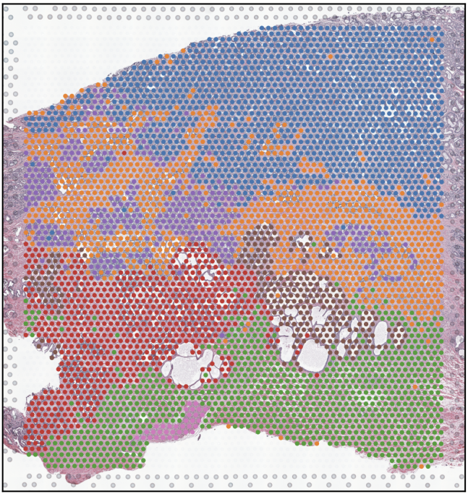
Clustering on Gene Sequence Data
Input: Spatial RNA-seq expression data given in H5 files
Combine this data with associated spatial data
Output: Create a Clustering ⇨ Cell types
H5 Data
+
Spatial Data
Clustering

Slide 6
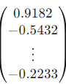
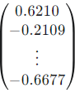
Supervised Learning Step
Input: Training Data Embedding
Labeled with Cell Type Cluster
Preprocessing: Scaling, PCA, Data Preparation
Embedding patch
Scaling &
PCA
Prepare training Data
Supervised
Learning
Preprocessing
Cell Type
…
Embedding patch
Supervised
Learning
Cell Type

Slide 7
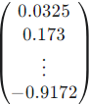
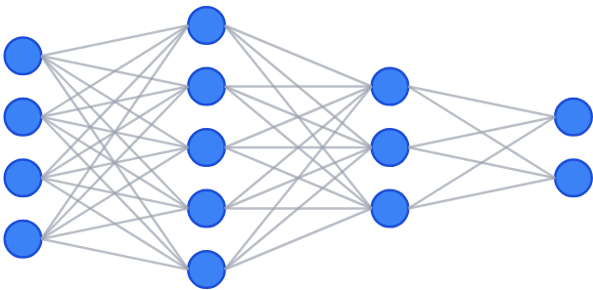
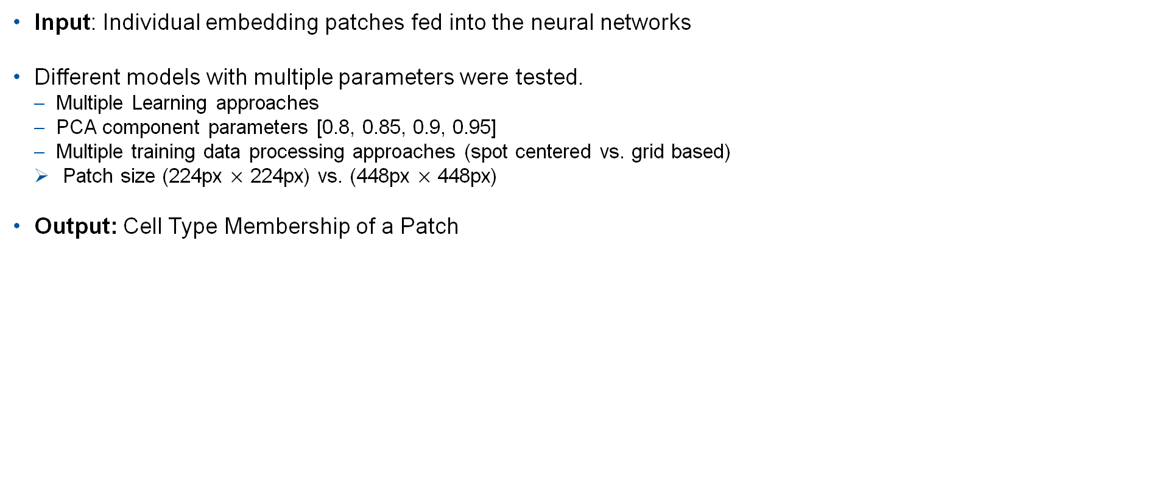
Classification
Input: Individual embedding patches fed into the neural networks
Different models with multiple parameters were tested.
Multiple Learning approaches
PCA component parameters [0.8, 0.85, 0.9, 0.95]
Multiple training data processing approaches (spot centered vs. grid based)
Patch size (224px $×$ 224px) vs. (448px $×$ 448px)
Output: Cell Type Membership of a Patch
Cell Type
Cluster 1
PCA
…
…
Cluster 5
Cluster 4
Patch size selection,
spot centered vs. grid based
0.8, 0.85, 0.9, 0.95
vs. no PCA
DNN, CNN, SVM

Slide 8
Preparation of Training Data

Slide 9
Label Assignment to Patches: Clustering
Choices to make:
Clustering algorithm
Clustering resolution
Algorithms: Leiden, Louvain, K-Means, Hierarchical
Clustering metrics:
Intrinsic (biological) clustering metrics
Clustering metrics based on ground truth (ARI, etc.)
Notes:
We do not use the pathologist annotations as our ground truth/ label to predict
Instead we cluster the gene data and use the cluster label as the ground truth we want to predict
This means the choice of the cluster resolution is extremely important
To select an appropriate clustering resolution we look at an array of clustering metrics, both internal and ones aiming to capture biological coherence of the clusters

Slide 10
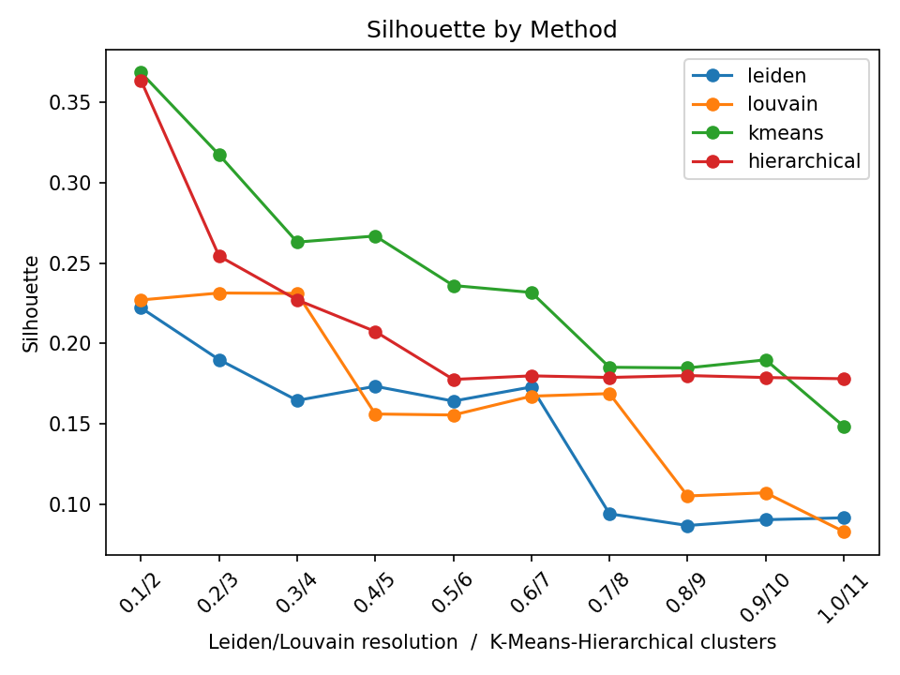
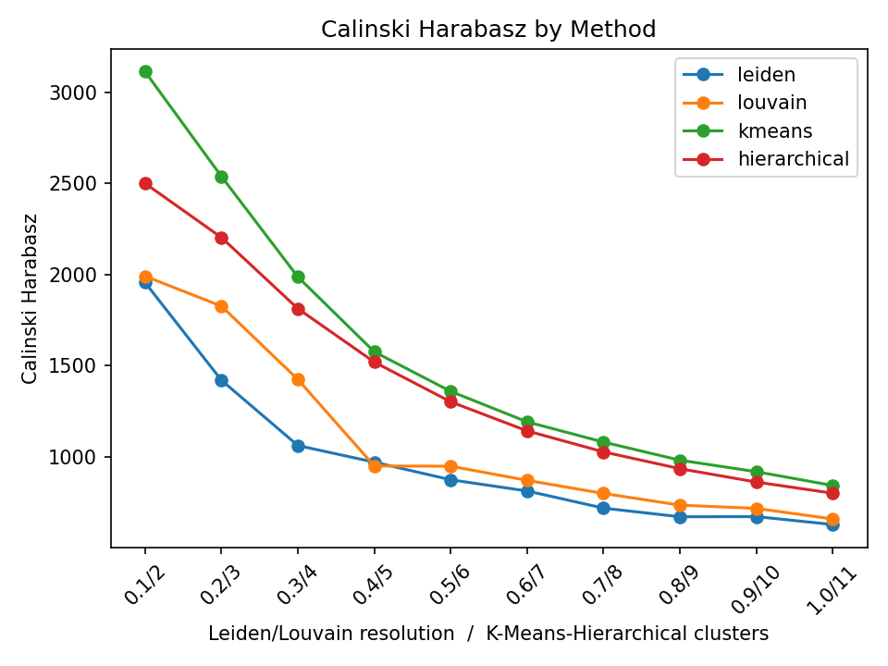
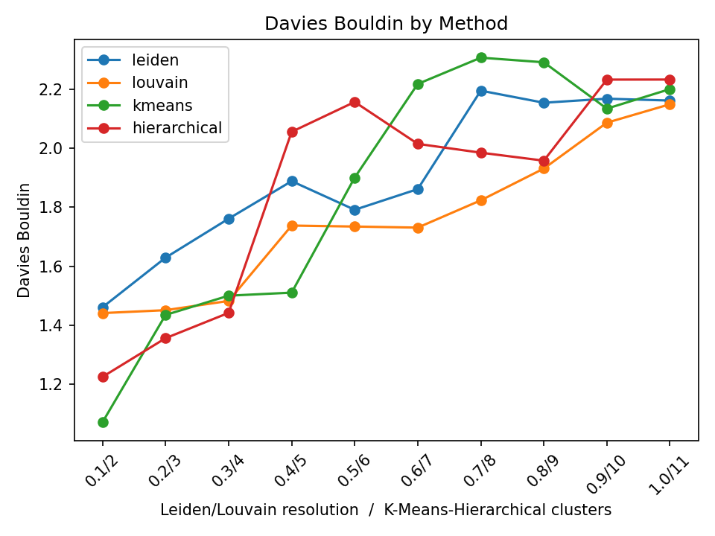
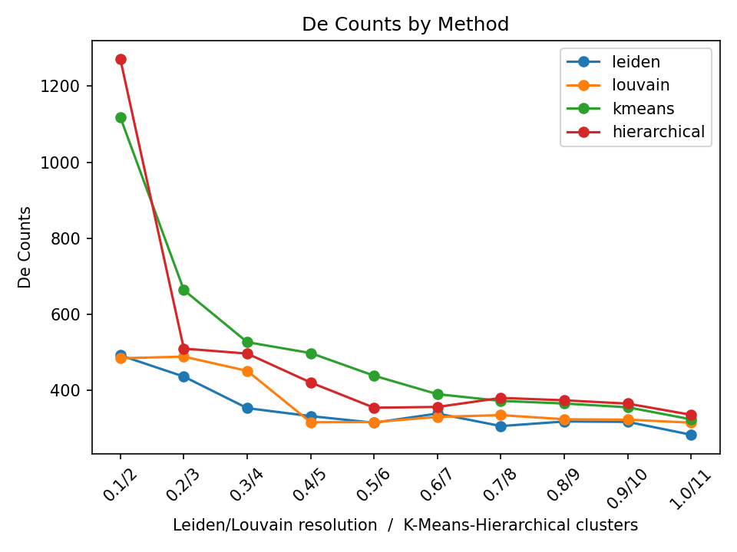
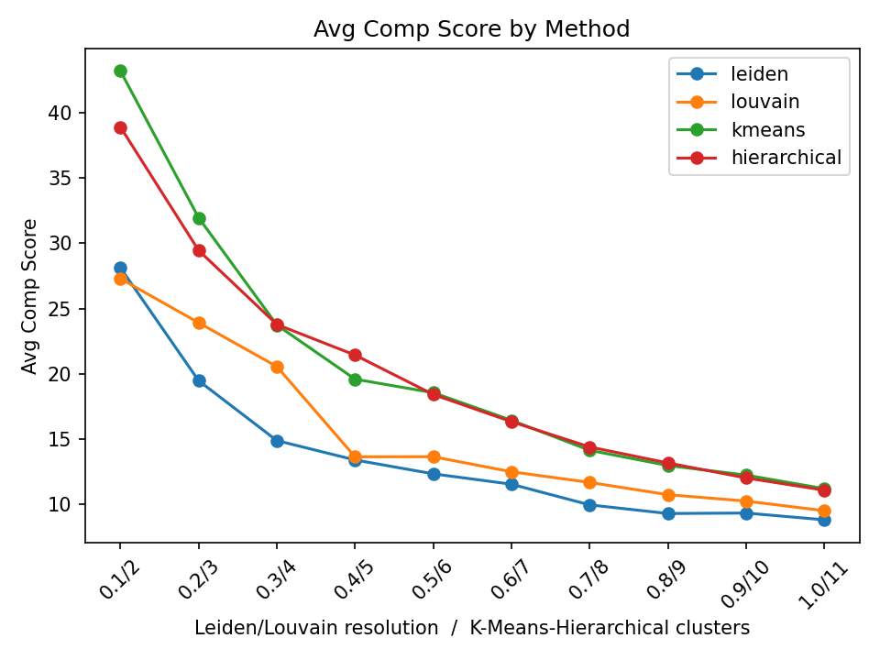
Label Assignment to Patches: Clustering - Clustering resolution choice
Intrinsic clustering metrics
Biological signal metrics ( Marker genes from CellMarker 2.0 [2])
Largely inconclusive ➔ Evaluate ground truth clustering metrics
Notes:
X-axis is resolution / k/ number of clusters for hierarchical
Clustering metrics that evalaute compactness and separation to other clusters:
Silhoutte score
Calinski–Harabasz index
Inrinsic clustering metrics are largely inconclusive so we also evaluate methods metrics that make use of a ground truth
Indications that 0.3/0.4 resolution seems good but we also take a look at clustering resolution with ground truth labels
Michaela:
Leiden is the go to standard for clustering scRNA data
We choose resolution of 0.3 as this aligns with our results (with reasons)

Slide 11
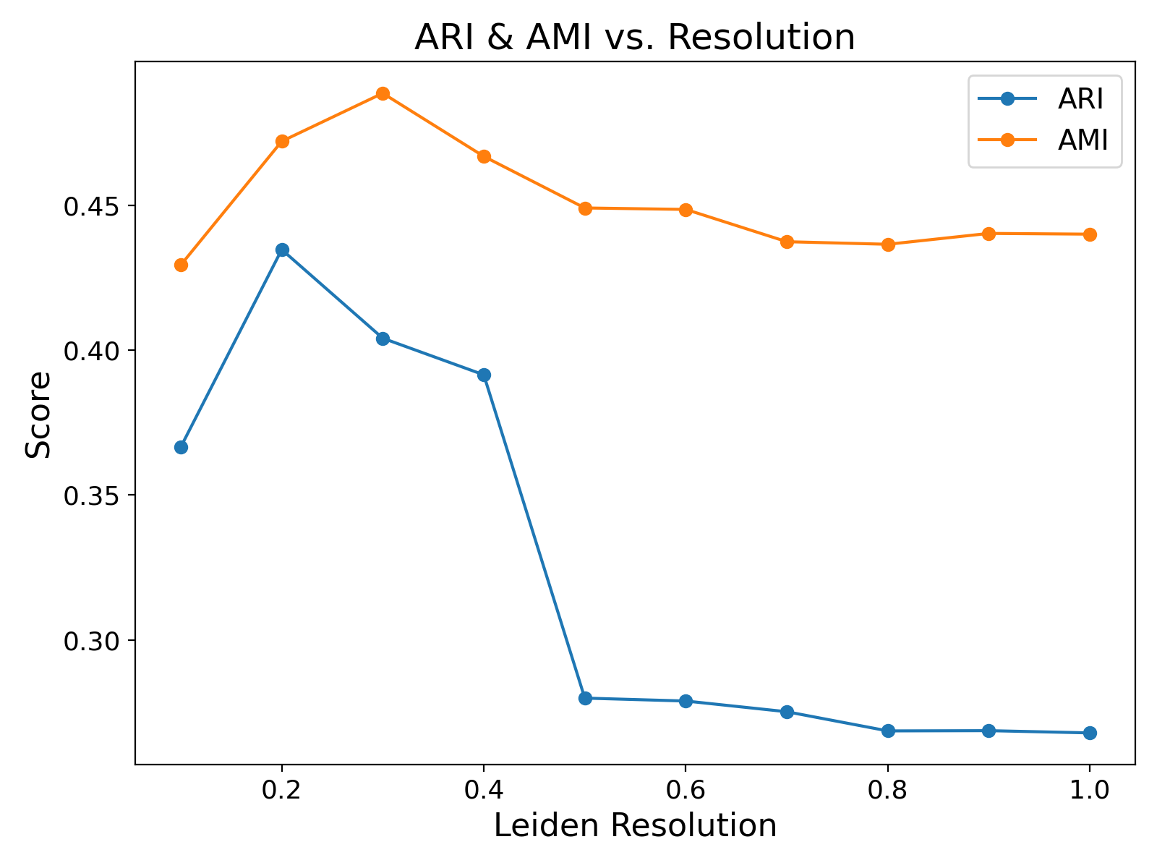
Clustering Evaluation based on pathology comparison
Metric Scores Based on Ground Truth
Pathology annotations define cell type regions globally
Comparing clustering results with these annotations provides biological context
Supervised scores:
ARI (Measures agreement between clustering and annotation, adjusted for chance)
AMI (Quantifies shared information between clustering and annotation, corrected for chance)
Given all scores combined, leiden clustering with a resolution of 0.3 is selected as a suitable trade-off

Slide 12

Label Assignment to Patches
Labeled training data needed for supervised training
Features: patch embeddings
Each spot has a label = cell type (cluster)
Problem:
Label per patch (embedding) required
Two variants to obtain patches:
Center squares around spots
Subdivide image into grid of patches

Slide 13
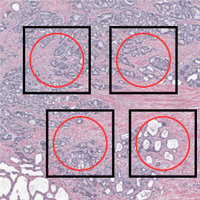
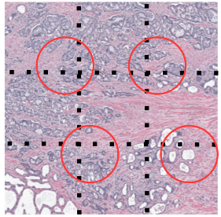
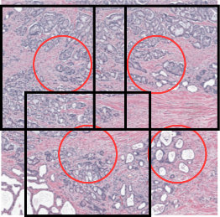
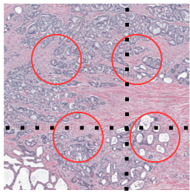
Label Assignment to Patches
Resolution | Spot-centered | Grid-based
224 x 224
448 x 448
Centered around spots | Grid based
1-to-1 correspondence between spots and patches Label of patch = label of spot + No additional label assignment logic required | No alignment between spots and patches Method for determining patch label required Calculate overlaps and do majority voting + Potentially more labeled patches + No overlaps and gaps between patches

Slide 14
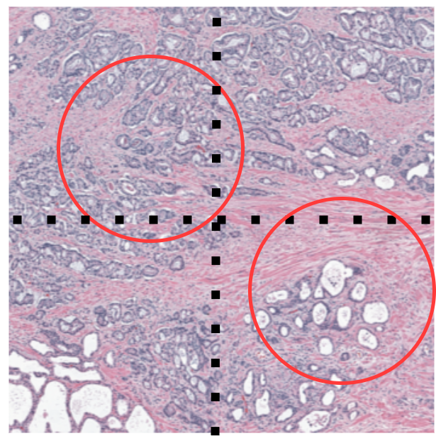
Label Assignment to Patches
Grid-based Label Assignment
Per patch:
Compute overlaps of spots with patch
Assign label based on overlap-weighted majority voting
Compute confidence score for label assignment
Used for supervised learning
Score based on:
Label agreement for overlapping spots
Amount of overlap

Slide 15
Supervised Learning Approaches for Cell Type Prediction

Slide 16
Approaches for Cell Type Prediction using Histology Data
Approaches:
Based only on Histology Data
Single Patch
Multi Patch
Based on Histology Data + Gene expression

Slide 17
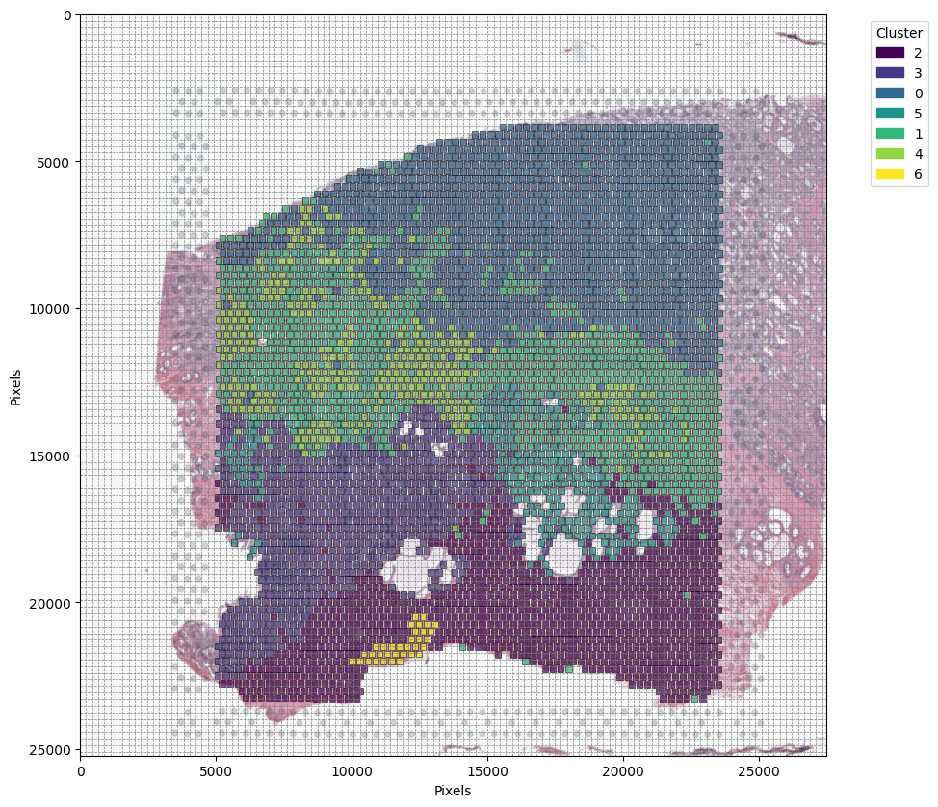

Supervised Learning Method – Single Patch
Training data – spot-centered
224 x 224 pixels patches
4371 patches
7 classes
448 x 448 pixels patches
4371 patches
7 classes

Slide 18
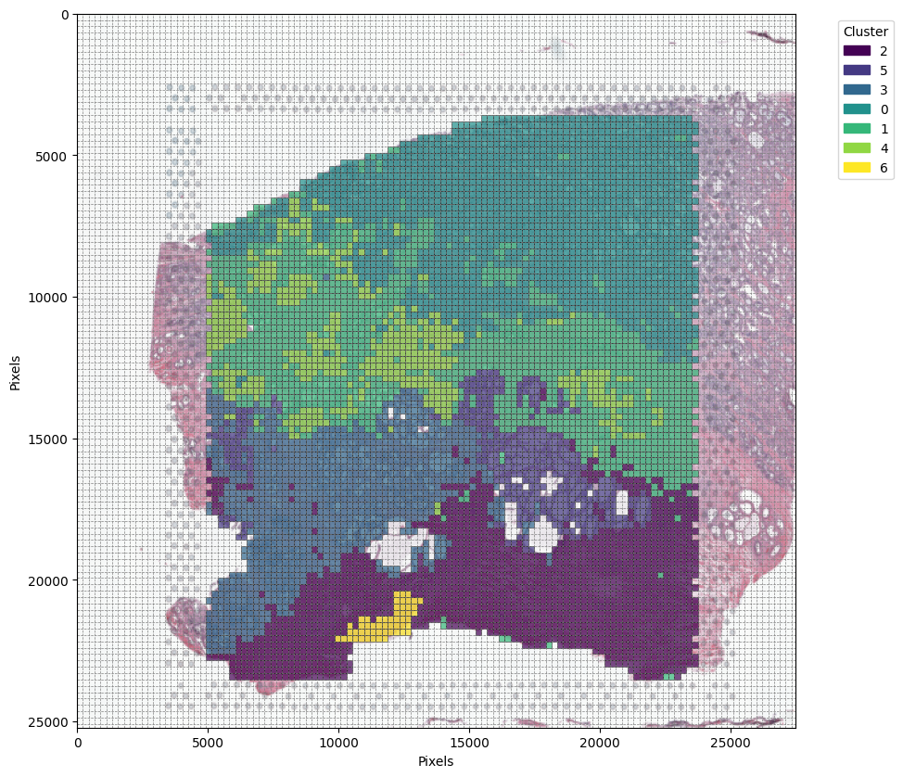
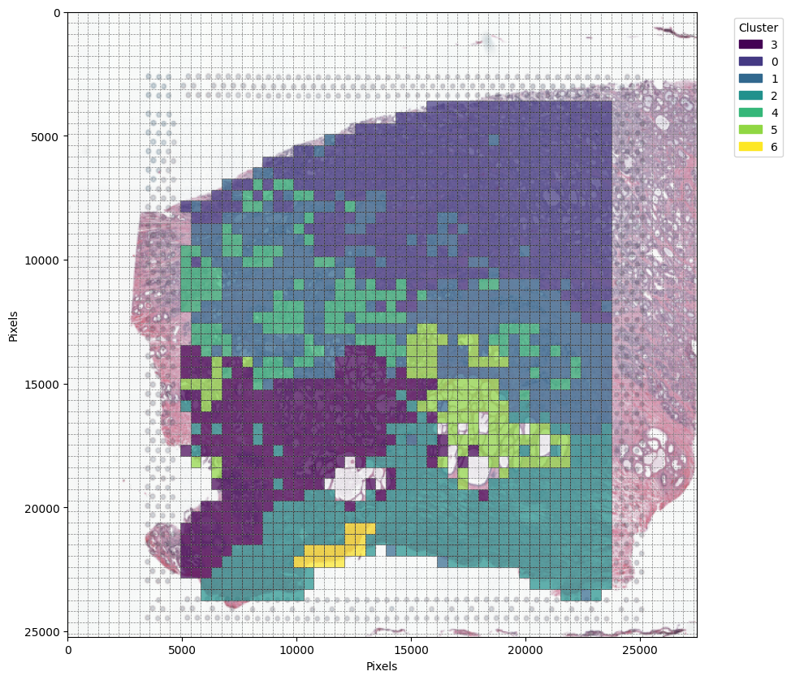
Supervised Learning Method – Single Patch
Training data – grid-based
224 x 224 pixels patches
6551 patches
7 classes
448 x 448 pixels patches
1644 patches
7 classes

Slide 19
Supervised Learning Method – Single Patch
Training Setup
Input data preprocessing:
Standard scaling
PCA with different variance reductions amounts:
80%, 85%, 90%, 95%, and without
= 111, 159, 240, 413, 1536 input features
Models tested:
SVM
With standard parameters
DNN
Size: input dim -> 256 -> 128 -> number of classes
Utilizes batch normalization and dropout
CNN
Size: 2 convolutional layers, 2 fully connected layers
Utilizes batch normalization and dropout
Attention model
Tested but very slow training and slightly worse results
No further evaluation

Slide 20
Supervised Learning Method – Single Patch
Confidence-based Training
Recall:
Additional confidence score per training sample in grid-based patch extraction
Measures confidence of label assignment
Confidence scores used as weighing factors in loss function
Concentrate on correct prediction samples with high confidence on correct label assignment
Only applied to DNN and CNN training

Slide 21
Supervised Learning Method – Single Patch
Evaluation Methodology
Split data into:
Training data, validation data, test data (stratified)
Obtain best configuration via grid search on validation results
Test best configuration on test data
Scores for evaluation:
Accuracy, F1 score, ARI score

Slide 22
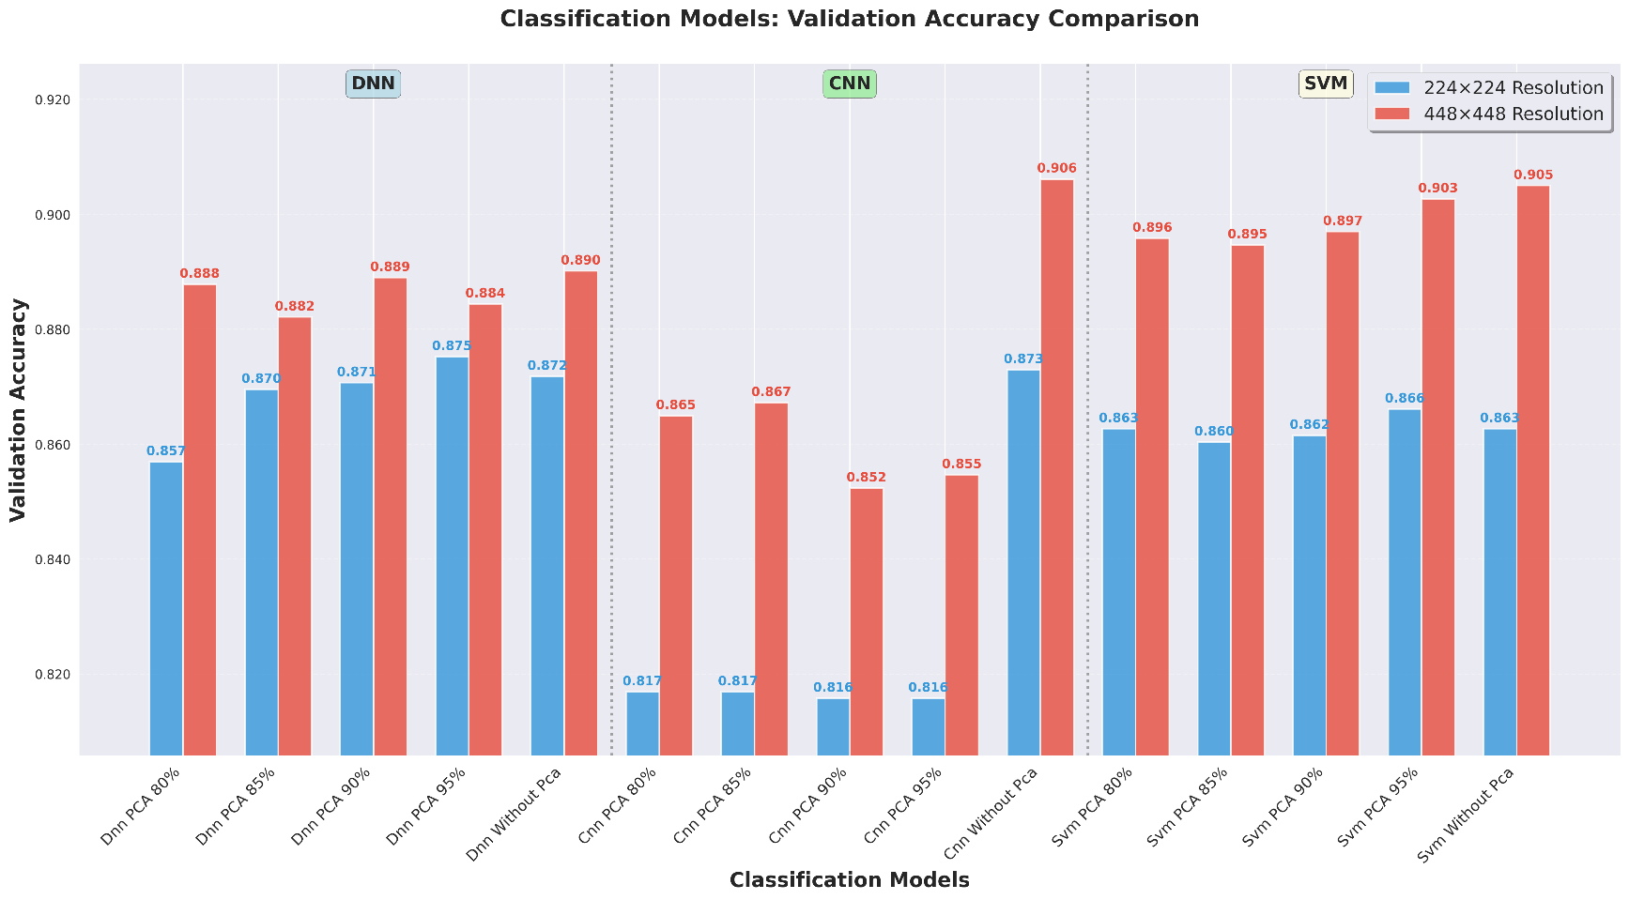
Supervised Learning Results – Single Patch
Spot-centered training data:

Slide 23
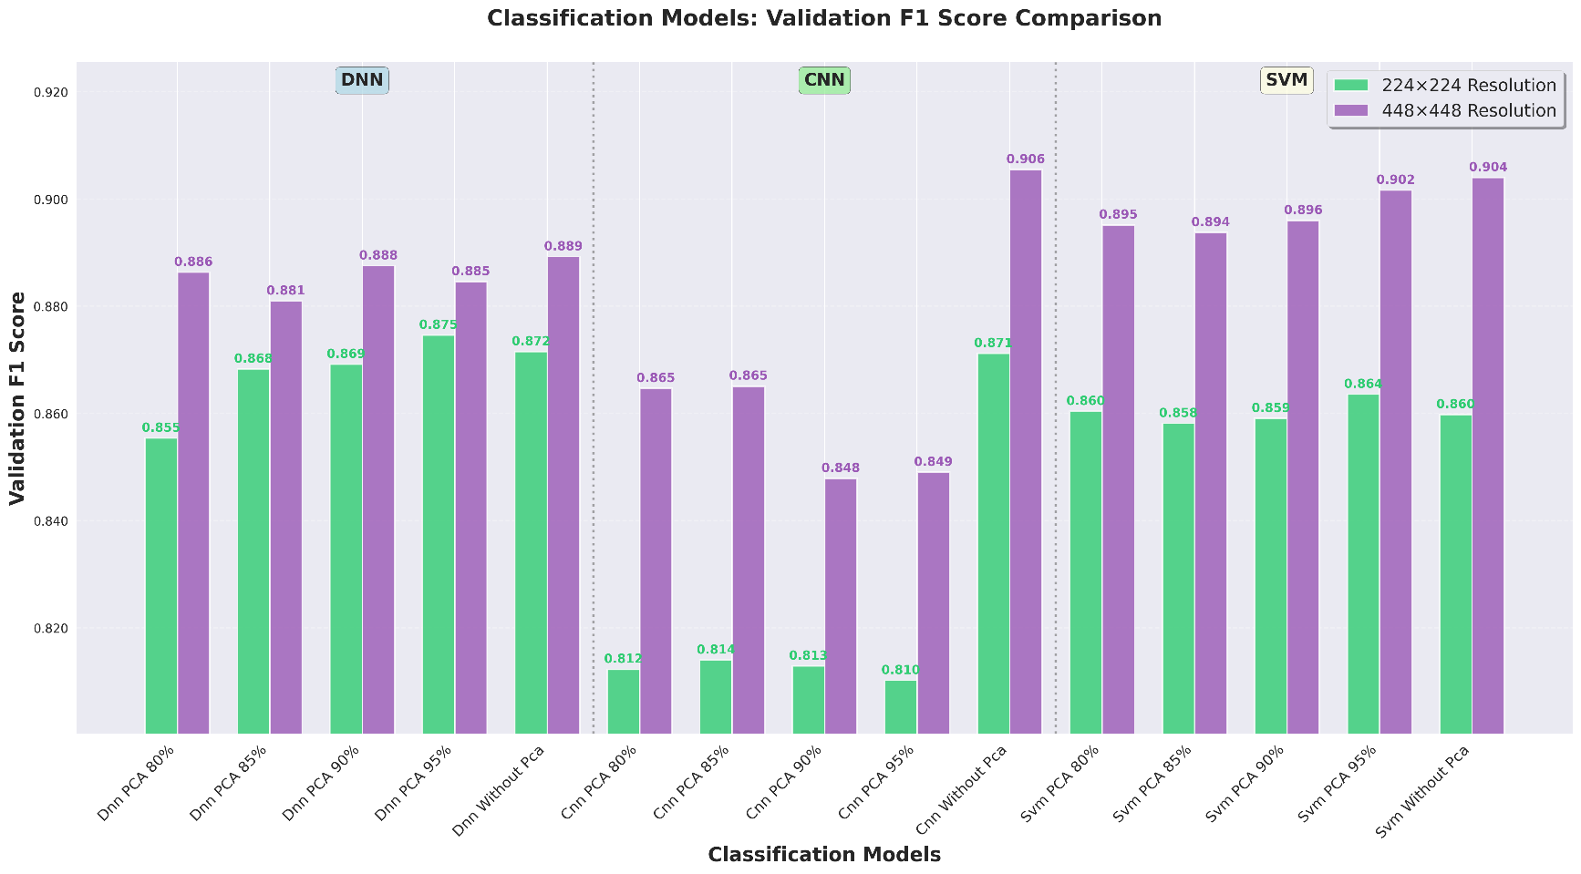
Supervised Learning Results – Single Patch
Spot-centered training data:

Slide 24
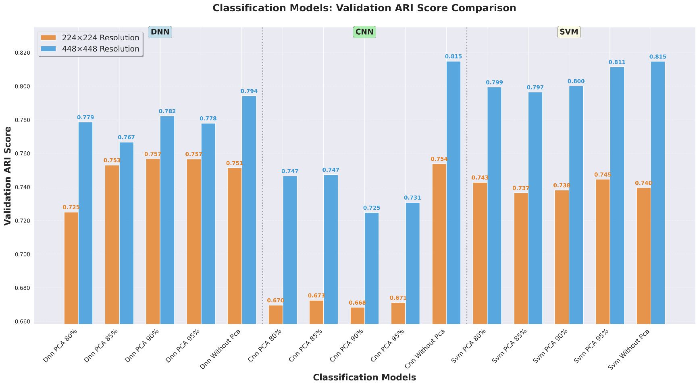
Supervised Learning Results – Single Patch
Spot-centered training data:

Slide 25
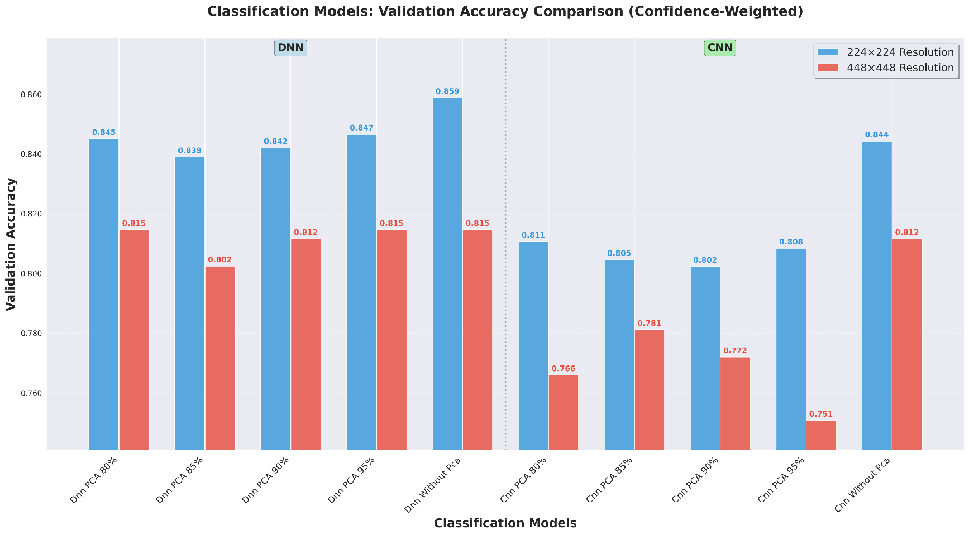
Supervised Learning Results – Single Patch
Grid-based training data:

Slide 26
Supervised Learning Results – Single Patch
Key Observations
Using 448x448 patches makes a big difference
Excluding PCA gives better results
CNN and SVM show highest performances
Test scores for best configurations:
Metric | Spot-centered | Grid-based
Accuracy | 0.90 | 0.85
F1 score | 0.90 | 0.85
ARI score | 0.80 | 0.69

Slide 27
Supervised Learning Results – Single Patch
Performance on Unseen Tissue Slices
Evaluation data:
Tissue slice with human prostate cancer (acinar cell carcinoma)
Classification configuration:
DNN
Methodology:
Train model on full training data set (448x448)
Predict clustering-based cell types in unseen tissue slice
Performance measured on similarity between “ground-truth“-label cluster and predicted-label cluster (ARI score)
Comparison between spot-centered and grid-based training approach

Slide 28
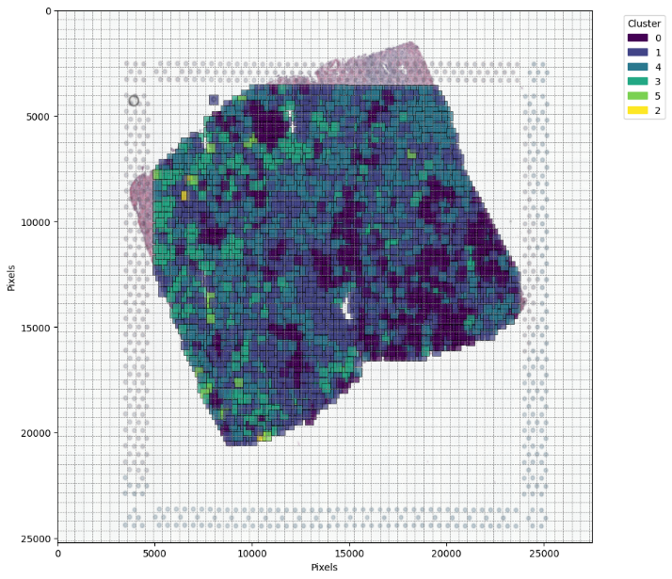
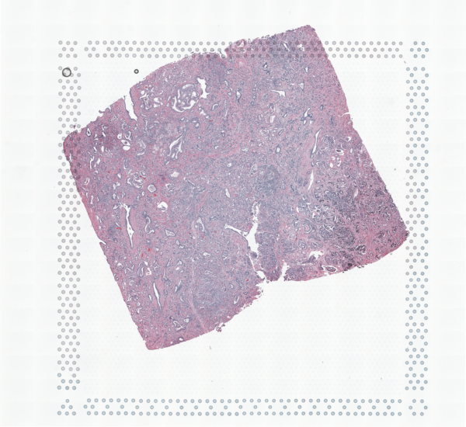
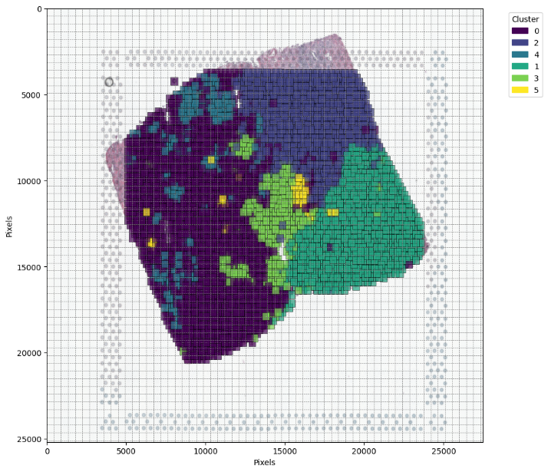
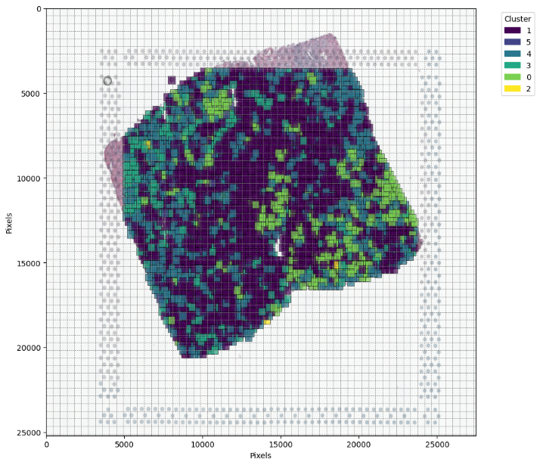
Supervised Learning Results – Single Patch
Performance Results on Unseen Tissue Slice
Spot-centered
ARI score:
0.067
Grid-based
ARI score:
0.058

Slide 29
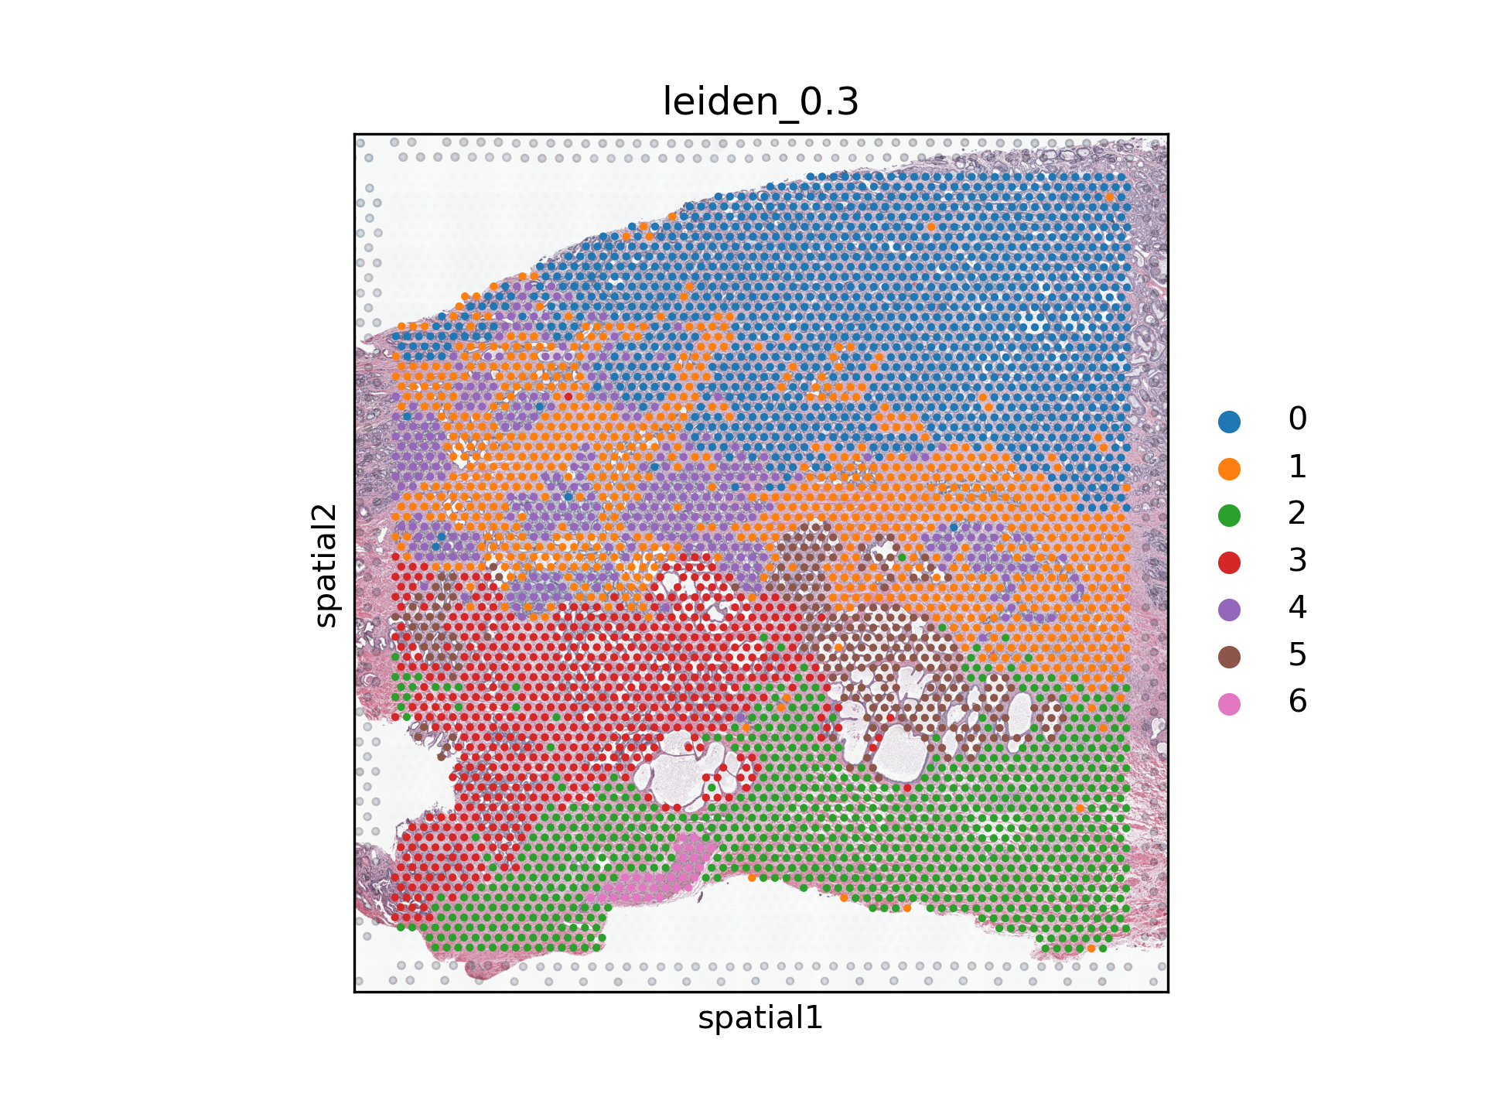
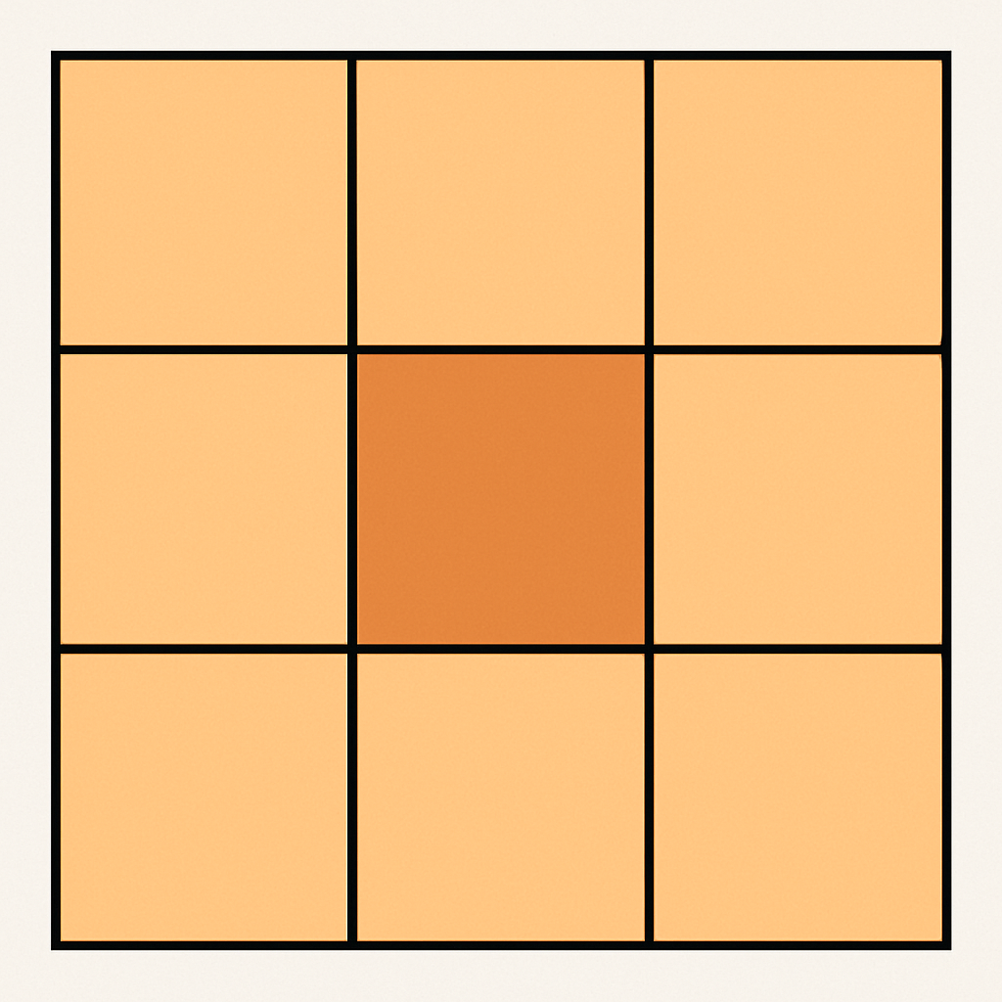
Classification Using Multiple Patches
Can cell type classification be improved by adding information from adjacent patches?
Same cell types might also cluster in tissue
Information from neighboring patches could improve results
Use grid structure of patches (224 x 224)
Consider embeddings from center patch plus its 8-neighborhood as features
Discard all patches that have a missing label in their 8-neighborhood
Train MLP classifier with targets obtained from leiden clustering
8-neighborhood:
cluster results

Slide 30
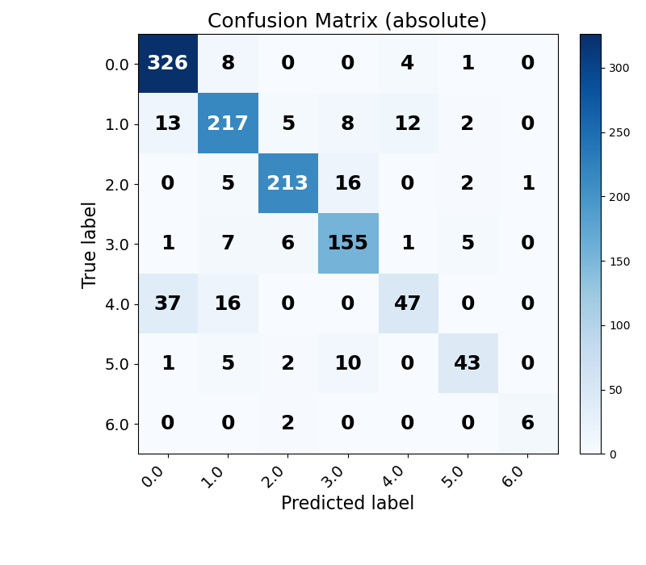
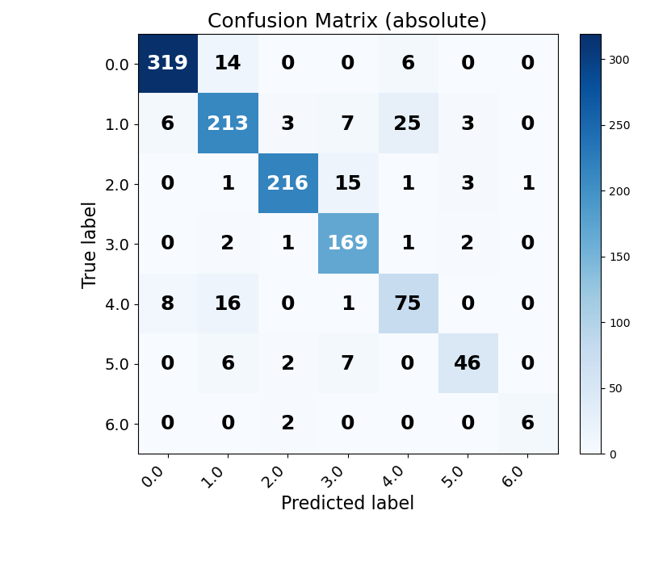
Classification Using Multiple Patches
Results
Single patch test accuracy: 0.856
Multiple patch test accuracy: 0.887
Effects on different clusters vary but improve by relative numbers
Total accuracy can be improved by including information from neighborhood
Single Patch
Multiple Patches

Slide 31
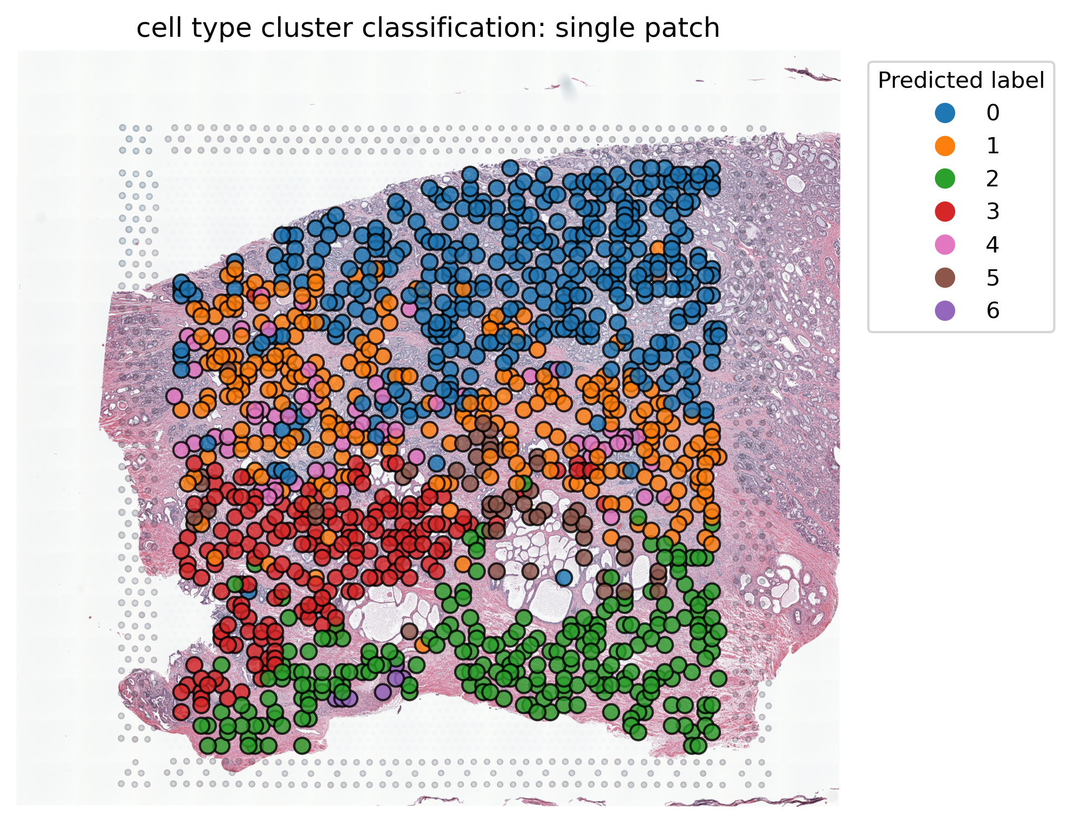
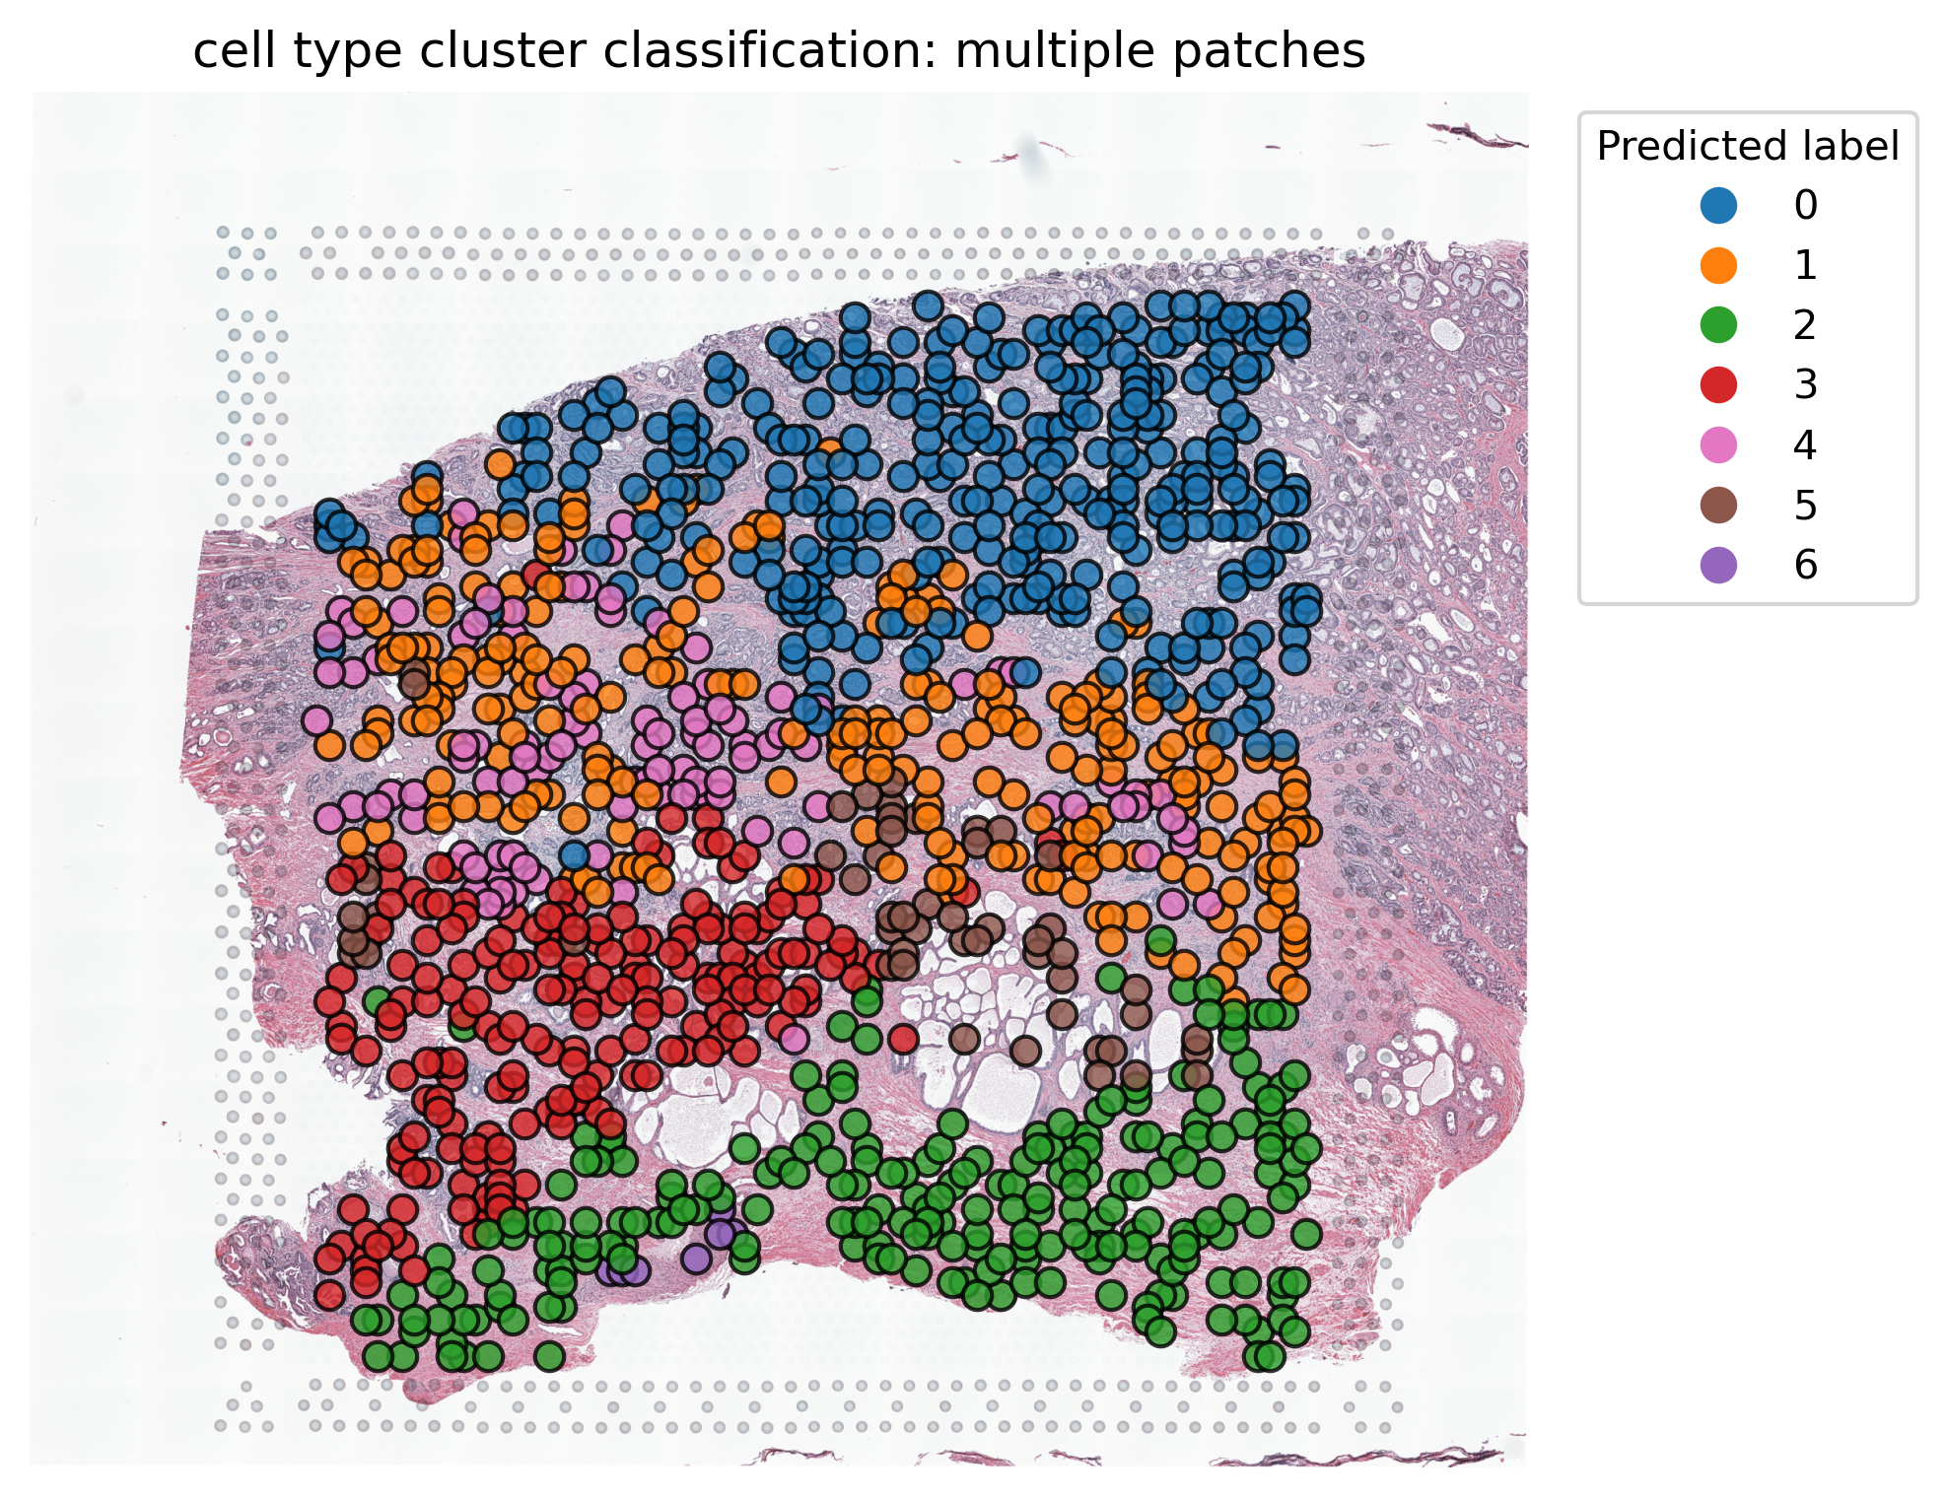
Classification Using Multiple Patches
Visualisation of Prediction
Single Patch
Multiple Patches

Slide 32
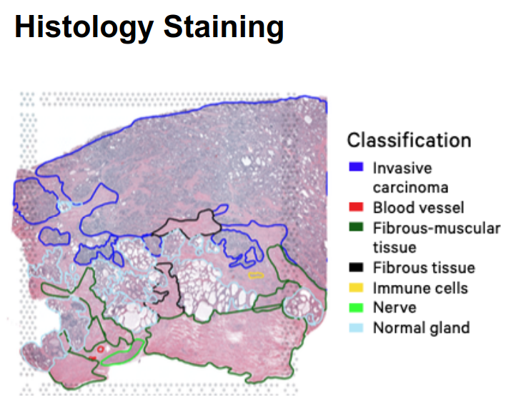
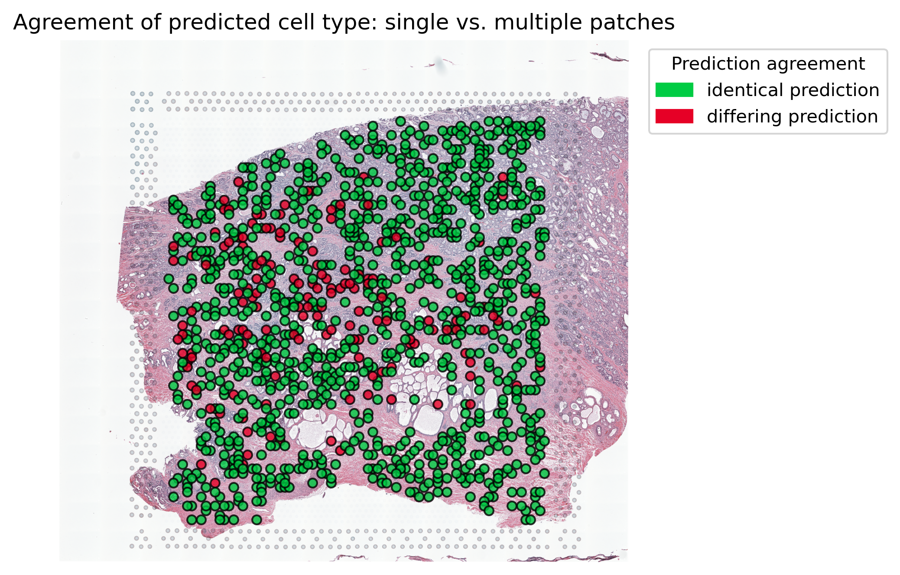
Classification Using Multiple Patches​
Visualisation of Difference Single/Multiple Patches Classification
Differing predictions mostly are from different leiden clusters but same cell type region.

Slide 33
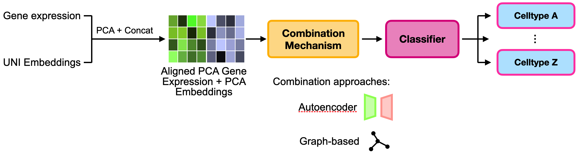
Classification: Histology + Gene Expression
Overview of steps:

Slide 34
Classification: Histology + Gene Expression
Overview of steps:
Working with spot centered data

Slide 35
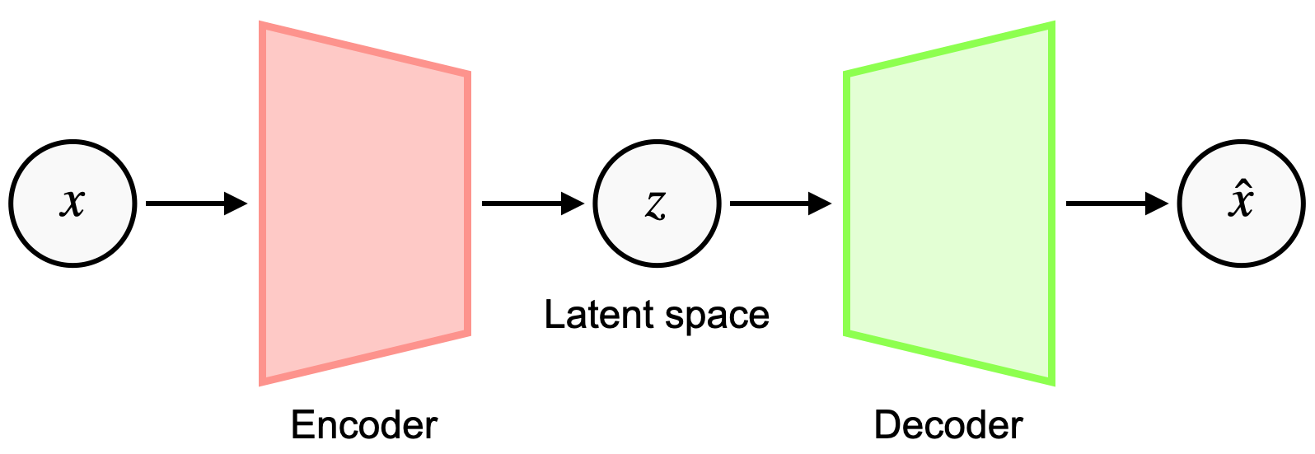
Classification: Histology + Gene Expression – Approach 1: Autoencoder
Core idea: Autoencoder has to learn compressed representation of data
Approach:
Train shallow AE
Throw away decoder
Ideally: Latent representation captures both modalities (Gene expression + Histology)
Notes:
AE architecture:
100 → 128 → 64 → 50 → 64 → 128 → 100
Relu
Dropout 0.2

Slide 36
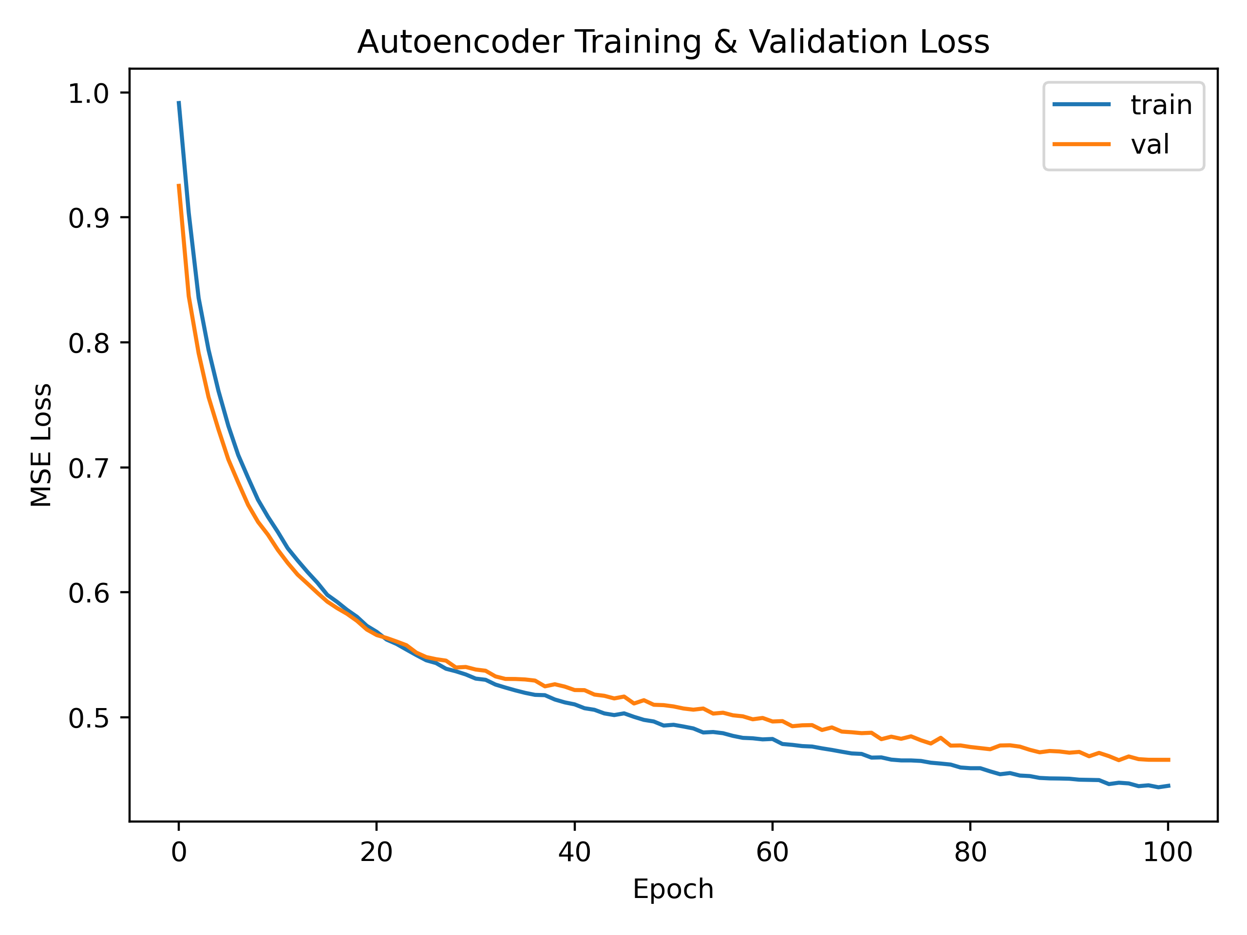
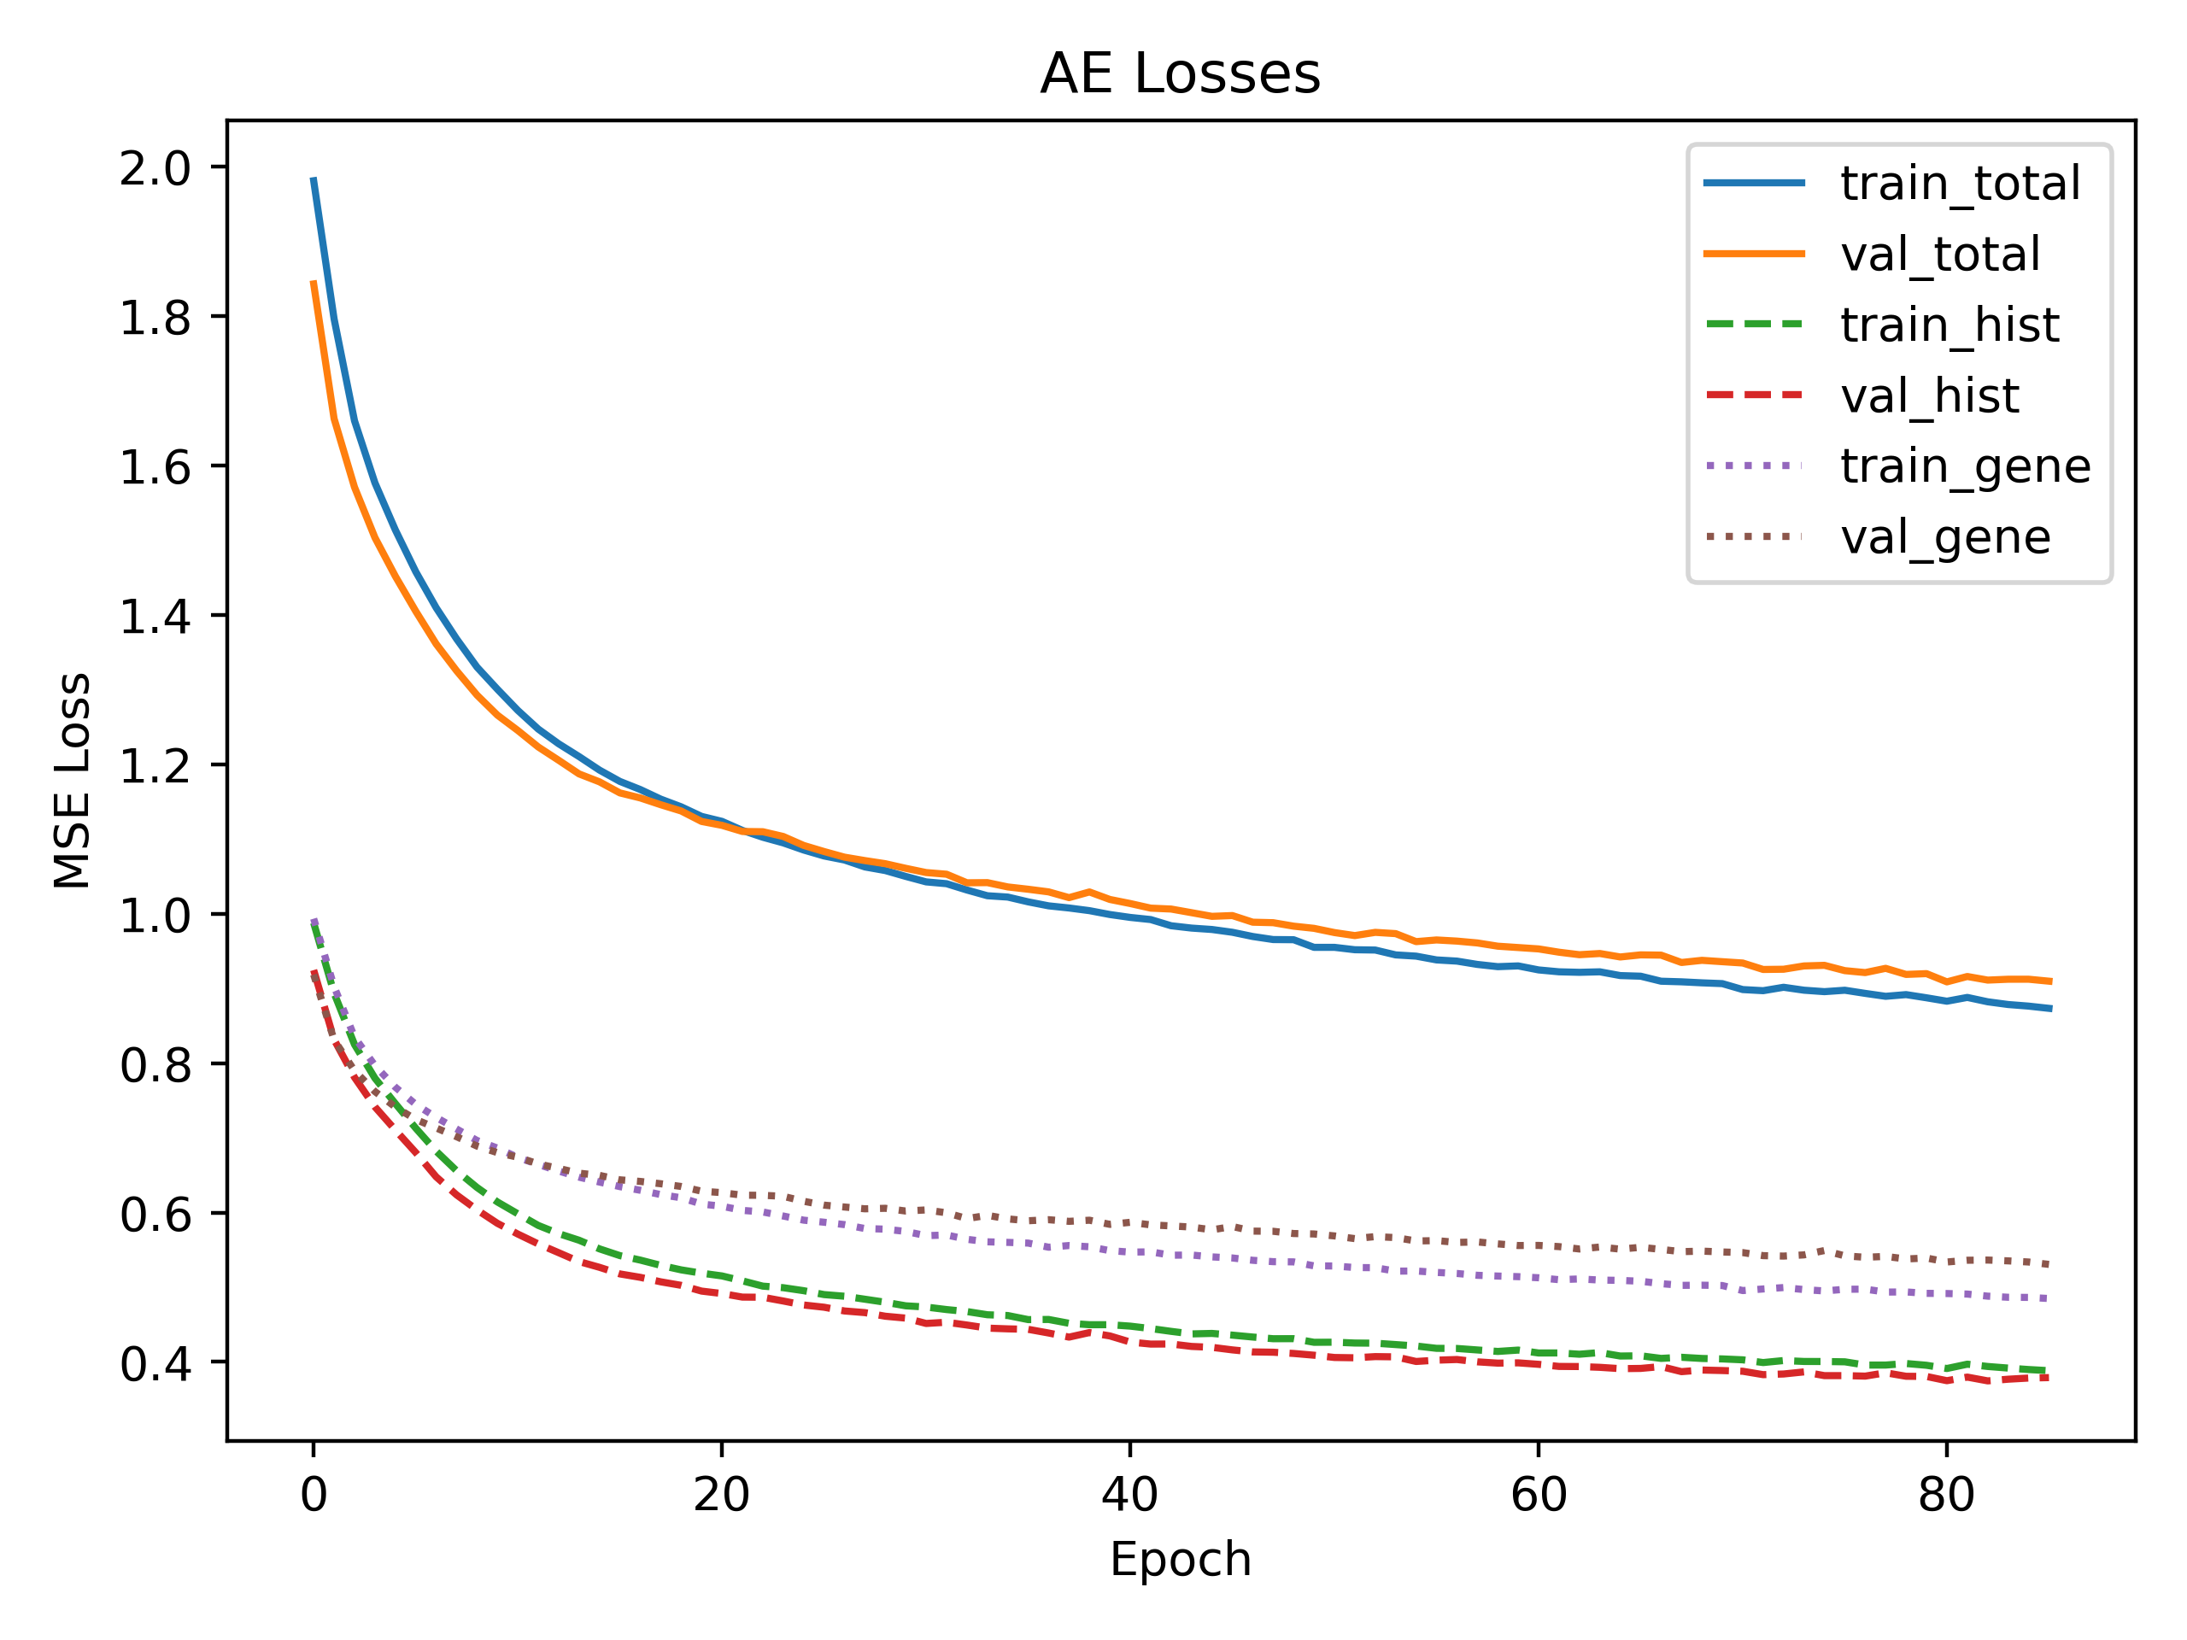
Classification: Histology + Gene Expression – Approach 1: Autoencoder
Is AE learning balanced representation of histology + gene expression?
→ Yes. Neither modality is being "ignored" in loss
Notes:
Loss function is MSE
We want to evaluate whether the AE is learning a balanced representation of gene expression and histology.
To do this we train the exact same autoencoder with a split loss for the gene expression and the histology
Interpretation standard AE loss curve:
train and val stay very close throughout, so no obvious over- or under-fitting
Interpretation split AE loss curve:
Total losses start near 2.0 (i.e. ~1.0+1.0) and decline to ~0.9 (i.e. ~0.38+0.52), exactly twice the scale of standard loss
Do standard AE and split AE optimize for the same objective
Yes. up to a constant scaling factor in the loss
Are the standard AE and sthe split AE the same? YES:
Gradient based optimizers invariant to overall constant scaling of the loss, both method drive netweork toward same reconstruction optimal parameters
Encoder archi and data are identical
Inference is identical
Important: number of dimensions for each modality is the same so both get weighted equally by AE

Slide 37
Classification: Histology + Gene Expression – Approach 1: Autoencoder
Is AE learning balanced representation of histology + gene expression?
→ Yes. Neither modality is being "ignored" in loss
Do standard AE and split AE optimize for same objective?
Notes:
Loss function is MSE
We want to evaluate whether the AE is learning a balanced representation of gene expression and histology.
To do this we train the exact same autoencoder with a split loss for the gene expression and the histology
Interpretation standard AE loss curve:
train and val stay very close throughout, so no obvious over- or under-fitting
Interpretation split AE loss curve:
Total losses start near 2.0 (i.e. ~1.0+1.0) and decline to ~0.9 (i.e. ~0.38+0.52), exactly twice the scale of standard loss
This comparison is only valid if the standard and the split AE are the same/ optimize for the same objective
So Do standard AE and split AE optimize for the same objective?
Yes. up to a constant scaling factor in the loss
Are the standard AE and sthe split AE the same? YES:
Gradient based optimizers invariant to overall constant scaling of the loss, both method drive netweork toward same reconstruction optimal parameters
Encoder archi and data are identical
Inference is identical
Important: number of dimensions for each modality is the same so both get weighted equally by AE

Slide 38
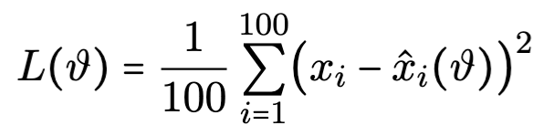
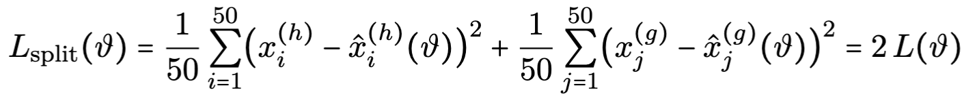
Classification: Histology + Gene Expression – Approach 1: Autoencoder
Is AE learning balanced representation of histology + gene expression?
→ Yes. Neither modality is being "ignored" in loss
Do standard AE and split AE optimize for same objective? → Yes
Standard AE loss:
(Standard MSE)
Split AE loss:
Same loss up to constant scaling factor
Notes:
Loss function is MSE
We want to evaluate whether the AE is learning a balanced representation of gene expression and histology.
To do this we train the exact same autoencoder with a split loss for the gene expression and the histology
Interpretation standard AE loss curve:
train and val stay very close throughout, so no obvious over- or under-fitting
Interpretation split AE loss curve:
Total losses start near 2.0 (i.e. ~1.0+1.0) and decline to ~0.9 (i.e. ~0.38+0.52), exactly twice the scale of standard loss
This comparison is only valid if the standard and the split AE are the same/ optimize for the same objective
So Do standard AE and split AE optimize for the same objective?
Yes. up to a constant scaling factor in the loss
We don't care about this factor because we just want to see how the two losses are in relation to one another
Are the standard AE and sthe split AE the same? YES:
Gradient based optimizers invariant to overall constant scaling of the loss, both method drive netweork toward same reconstruction optimal parameters
Encoder archi and data are identical
Inference is identical
Important: number of dimensions for each modality is the same so both get weighted equally by AE

Slide 39
Classification: Histology + Gene Expression – Approach 2: Graph-based Autoencoder
Based on SpaGCN [1]
SpaGCN key insight: Embed histology into a third coordinate so that two spots are “close” only if they’re both spatially and histologically similar
Notes:
We use k = 8
Reasoning behind no edge weights. We try to keep our model as simple as possible, as
Graph autoencoder has 3 blocks:
100 →[GraphSAGE]→ 64 →[GraphSAGE]→ 50 →[Linear decoder]→ 100

Slide 40
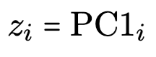
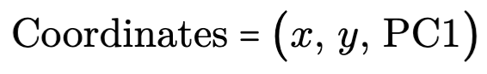
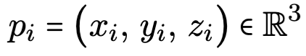

Classification: Histology + Gene Expression – Approach 2: Graph-based Autoencoder
Based on SpaGCN [1]
SpaGCN key insight: Embed histology into a third coordinate so that two spots are “close” only if they’re both spatially and histologically similar
Set up undirected graph:
One node per patch
Defining distance: Use first PCA component of histology embedding
3-Points for each node:
Build graph via 8-NN
Idea: Additional spatial information could aid cell type prediction
Notes:
We use k = 8
Reasoning behind no edge weights. We try to keep our model as simple as possible, as
Graph autoencoder has 3 blocks:
100 →[GraphSAGE]→ 64 →[GraphSAGE]→ 50 →[Linear decoder]→ 100

Slide 41

Classification: Histology + Gene Expression – Results
→ Standard autoencoder performs comparably to pure histology
→ Graph based approach improves scores
→ Slight improvement over pure histology approach
Notes:
Standard autoencoder:
model
accuracy
ARI
F1_weighted
DNN
0.896
0.790769555647297
0.895794549554238
CNN
0.8491428571428571
0.7013751180568615
0.849377301450626
SVM
0.8788571428571429
0.758265243894097
0.8785642540559485
Graph based:
model
accuracy
ARI
F1_weighted
DNN
0.9211428571428572
0.8355855557485877
0.9214333540280685
CNN
0.8731428571428571
0.7453913714003794
0.8731214548855708
SVM
0.9017142857142857
0.8004667327147147
0.901759879142762

Slide 42
Conclusion
Goal: Automatic cell type classification from histology
Approaches:
Histology based
Histology + gene expression based
Results:
Histology models:
Larger patch sizes improve performance
Performance on unseen data needs improvement
Histology + gene expression based models:
Histology + gene expression based models perform comparably
Slight improvement through graph based approach
→ To little data to make conclusive conclusions about performance of approaches
Future work:
More data
Possibly reduce cluster ambiguity by single cell instead of multi cellresolution
Graph based approach with weighted graph

Slide 43
Sources
[1]: SpaGCN, https://www.nature.com/articles/s41592-021-01255-8#Sec9
[2]: CellMarker 2.0, http://bio-bigdata.hrbmu.edu.cn/CellMarker/

Slide 45







Split loss AE Formulas
Standard AE loss:
Split AE loss:
Gradient descent only sees gradient of loss:
→ Exact same as original update but with new learning rate (direction of step is unchanged)
→ Adam normalizes away scale factor c
Notes:
Loss function is MSE
Interpretation standard AE loss curve:
train and val stay very close throughout, so no obvious over- or under-fitting
Interpretation split AE loss curve:
Total losses start near 2.0 (i.e. ~1.0+1.0) and decline to ~0.9 (i.e. ~0.38+0.52), exactly twice the scale of standard loss
Are the standard AE and sthe split AE the same? YES:
Gradient based optimizers invariant to overall constant scaling of the loss, both method drive netweork toward same reconstruction optimal parameters
Encoder archi and data are identical
Inference is identical
Important: number of dimensions for each modality is the same so both get weighted equally by AE

Slide 46
Histology Staining

